Slide 1
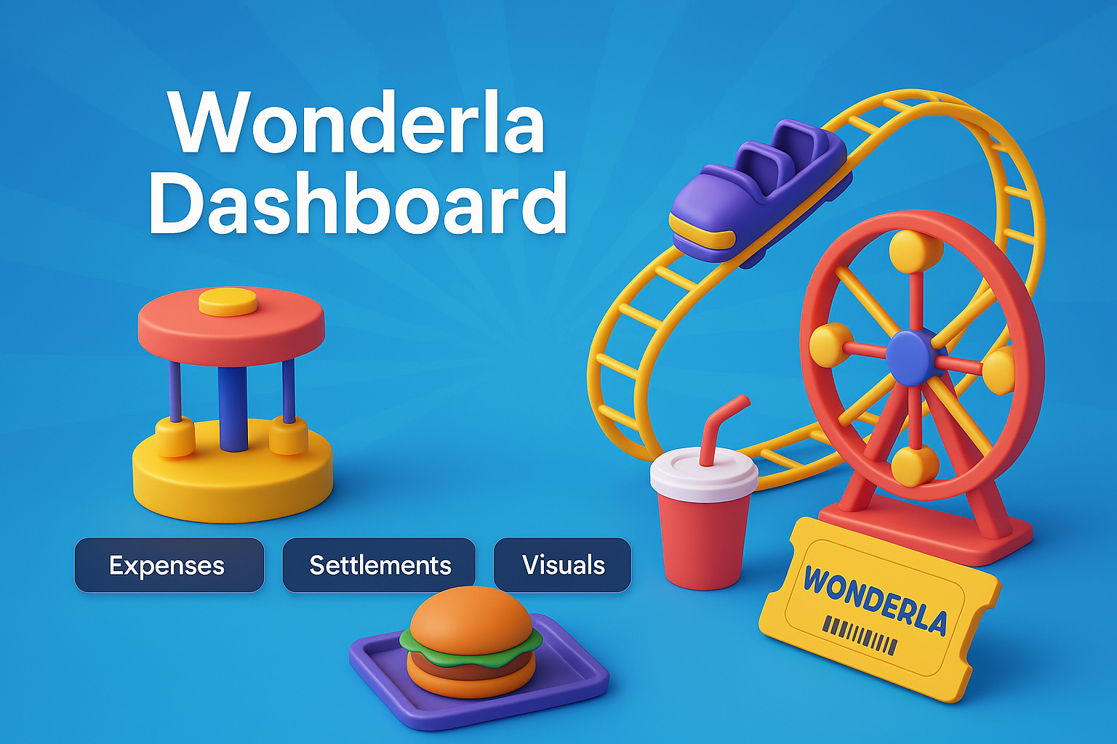
bbb

Slide 2

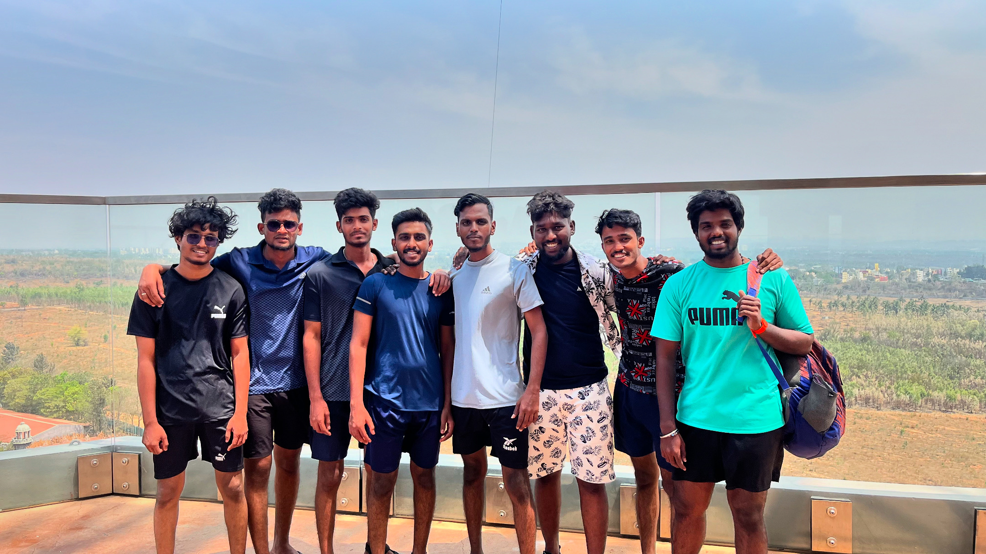
Hello Everyone
I’m Karthick, an aspiring Data Analyst passionate about turning real-life situations into data-driven insights. This is my first real-time data analysis project, based on a trip to Wonderla with 8 friends, where we tracked and analyzed our shared expenses. I wanted to apply my SQL knowledge in a practical way. Initially, I struggled with query logic and structuring, but through consistent practice and research, I overcame those challenges. This project gave me confidence and hands-on experience. However, I know this is just the beginning — I’m eager to learn more, improve my skills, and take on even more complex projects ahead.

Slide 3


Slide 4

All Questions
Basic:
Get total amount expenses in the overall wonderla trip.
Get the amount spent on snacks.
What are the expenses categories are there.
What is the total amount spent on food.
Which individual spent the least on travel.
What is the total amount spent on locker.
What is the total amount spent on dress.
Get the individual spent amount on overall trip.
Medium:
Which category had the second-highest total expenditure?
What is the total amount spent on Wonderla Pass by individuals who also spent on Snacks?
Which individual spent the most overall, and what is their total expenditure?
Which individual spent the most on Snacks?
Hard:
Ranks wise money spender based on expenses category exclude wonderla pass.
Get the rank wise money spender overall wonderla .
Day-wise Spending Trend by Category.

Slide 5

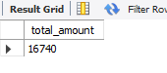
Get total amount expenses in the overall wonderla trip.

Slide 6
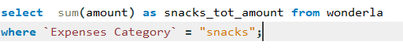
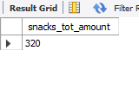
Get the amount spent on snacks.

Slide 7
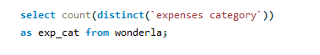
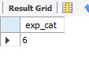
What are the expenses category are there.

Slide 8
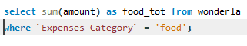
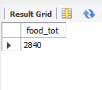
What is the total amount spent on Food?

Slide 9
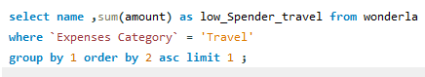
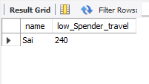
Which individual spent the least on Travel?

Slide 10
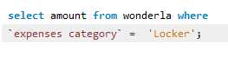
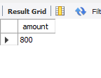
What is the total amount spent on Locker?

Slide 11
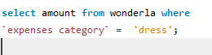
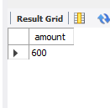
What is the total amount spend on Locker

Slide 12
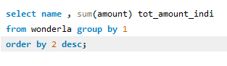
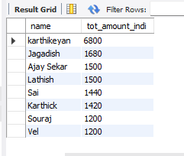
What is the total amount spent on Travel by all individuals?

Slide 13
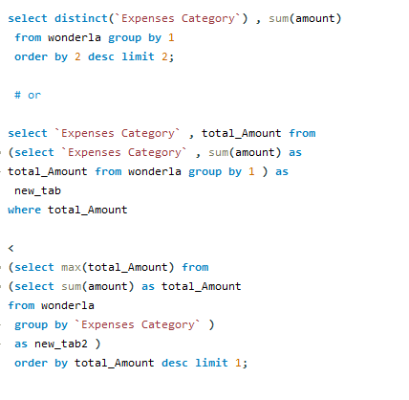
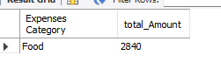
Which category had the second-highest total expenditure.

Slide 14
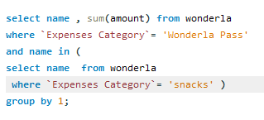
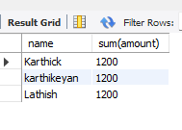
What is the total amount spend on wonderla pass
Who also spent on snacks.

Slide 15
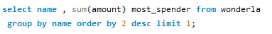
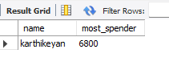
Which individual spent the most overall, and what is their total expenditure?

Slide 16
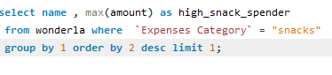
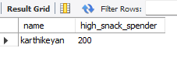
Which individual spent the most on Snacks?

Slide 17
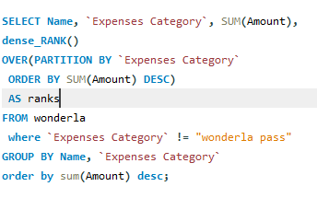
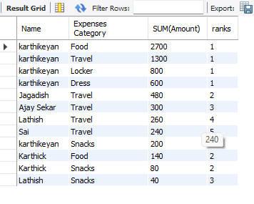
Ranks wise money spender based on expenses category exclude wonderla pass.

Slide 18
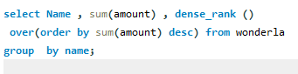
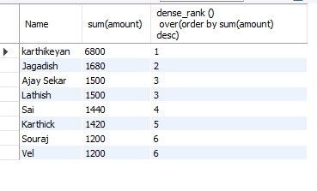
Get the rank wise money spender overall wonderla .

Slide 19
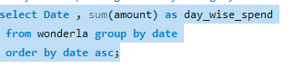
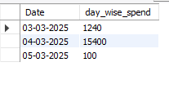
Day-wise Spending Trend by Category.

Slide 20


